Slide 1
Capstone 1
Analyze Global Sea Ice,
CO2 levels and Forest Fires
Slide Deck
Bogdan Sburlea - May 30th, 2020

Slide 2
OBJECTIVE:
Use statistical and machine learning techniques
for processing and drawing conclusions from
large public datasets regarding:
sea ice
CO2 levels
forest fires

Slide 3
Very different datasets:
ice data: ice cores and NOAA datasets
CO2 data: Mauna Loa NOAA datasets
forest fires data: VIIRS, FIRMS and MODIS satellite datasets
Issues with the datasets:
missing data
different accuracy
different sampling

Slide 4
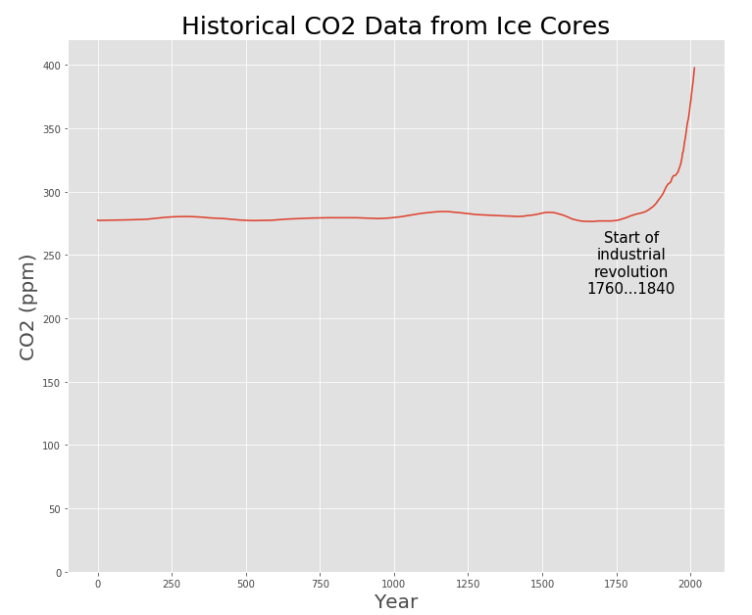
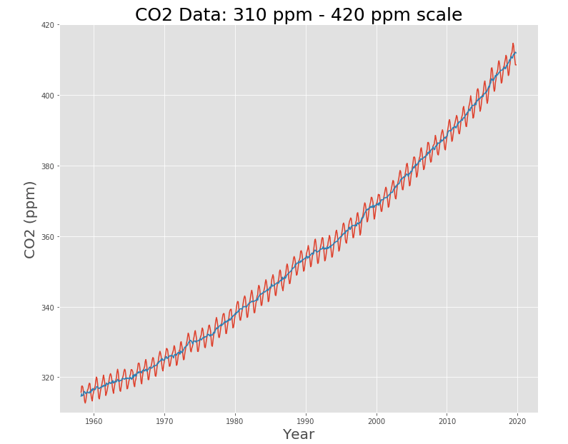
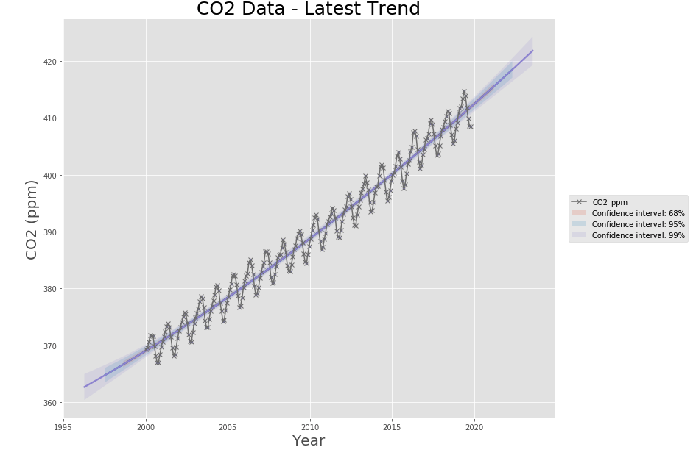
CO2 Data
Historically, CO2 levels were very stable around 280 ppm for 1800 years
The industrial revolution started a positive CO2 trend
For the last 20 years this trend is exponential

Slide 5
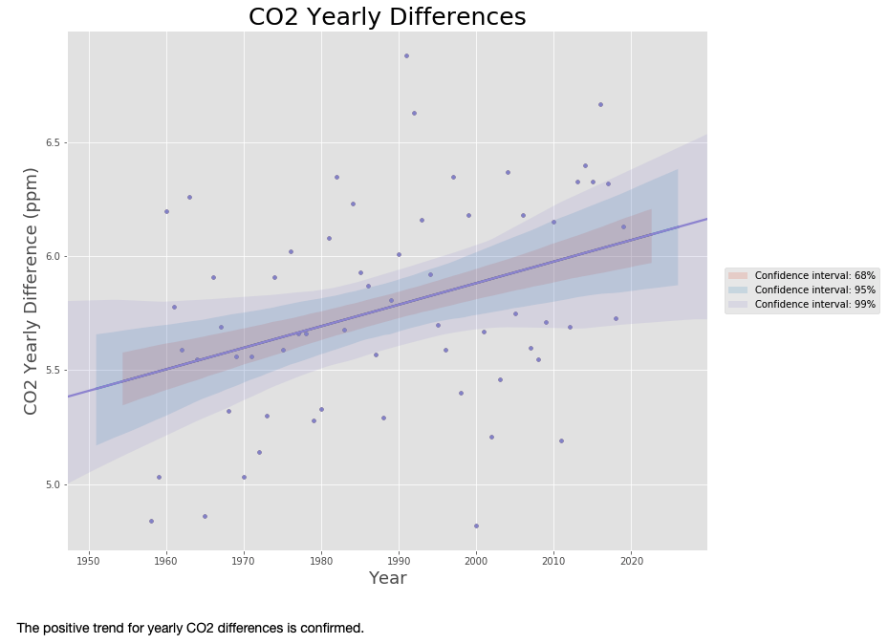
There are seasonal patterns for CO2 concentration due to different land mass
for the Northern and Southern hemisphere
The seasonal difference is increasing for the last 70 years

Slide 6
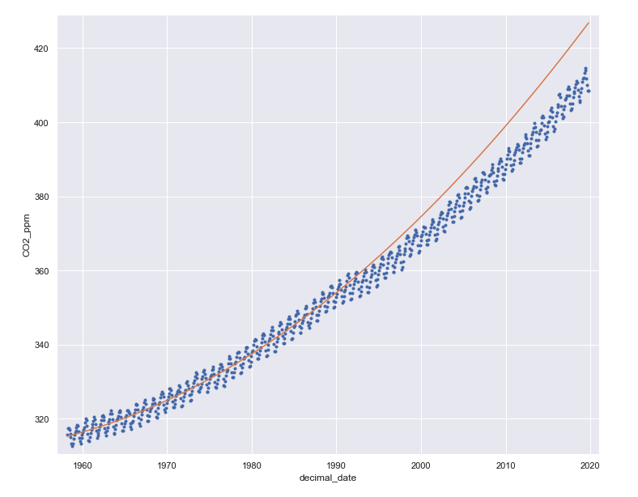
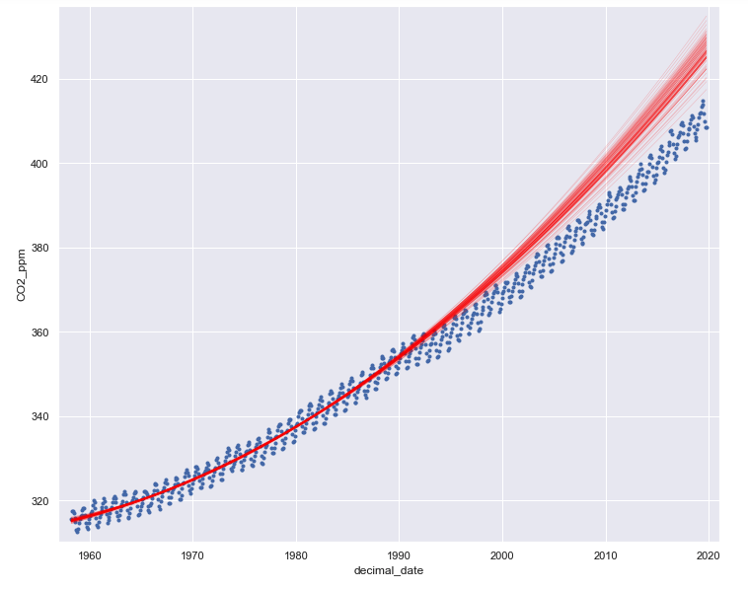
Co2 anomaly around 1990…1995 (left)
Bootstrap replicates show extrapolations for pre 1990 data

Slide 7
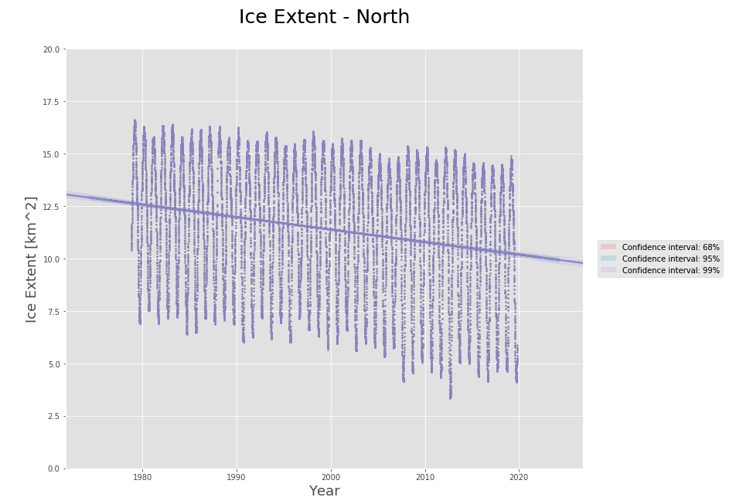
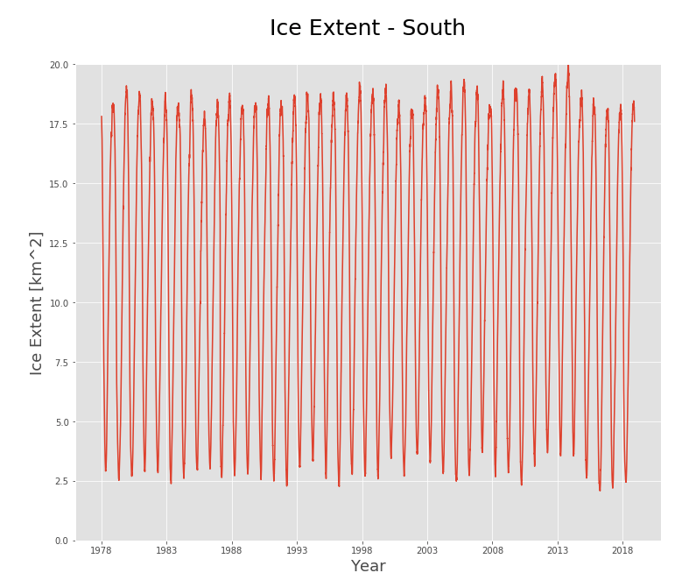
Ice Data
Ice extent for the Northern Hemisphere is decreasing
Ice extent for the Southern Hemisphere shows no trend

Slide 8
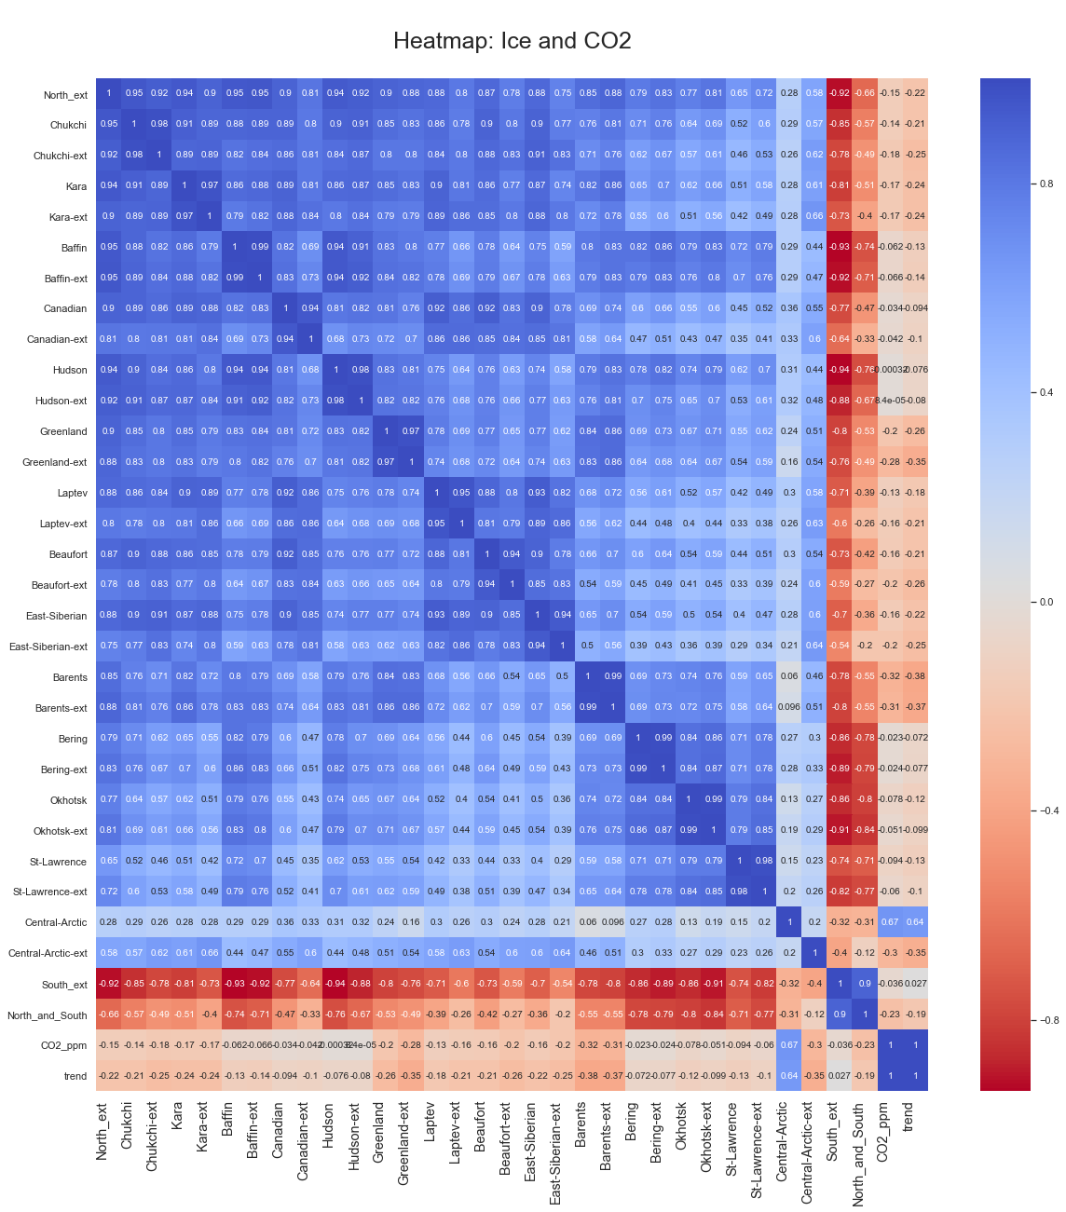
as expected, all Northern
Hemisphere sea ice variations
are positively correlated
the highest correlation is for
Chukchi Sea that shows a
strange pattern at the end
of 2019 (next slide)

Slide 9
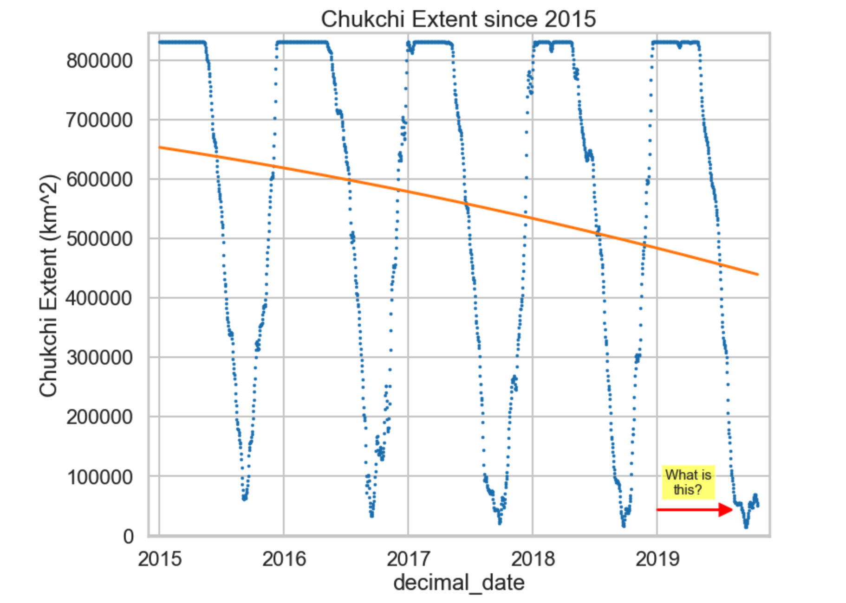
For Chukchi Sea the ice
data for the end of 2019
(month of November)
shows values close to
zero km2 sea ice. That
reading is common for
summer months (June, July,
August), not for November

Slide 10
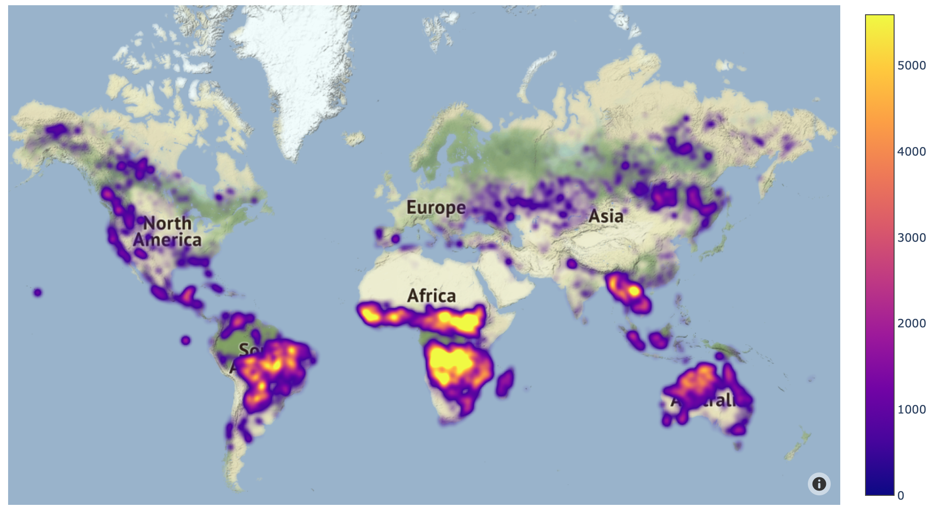
Forest Fires
Areas for forest fires:
Africa
Amazon Area
Australia
SE Asia

Slide 11
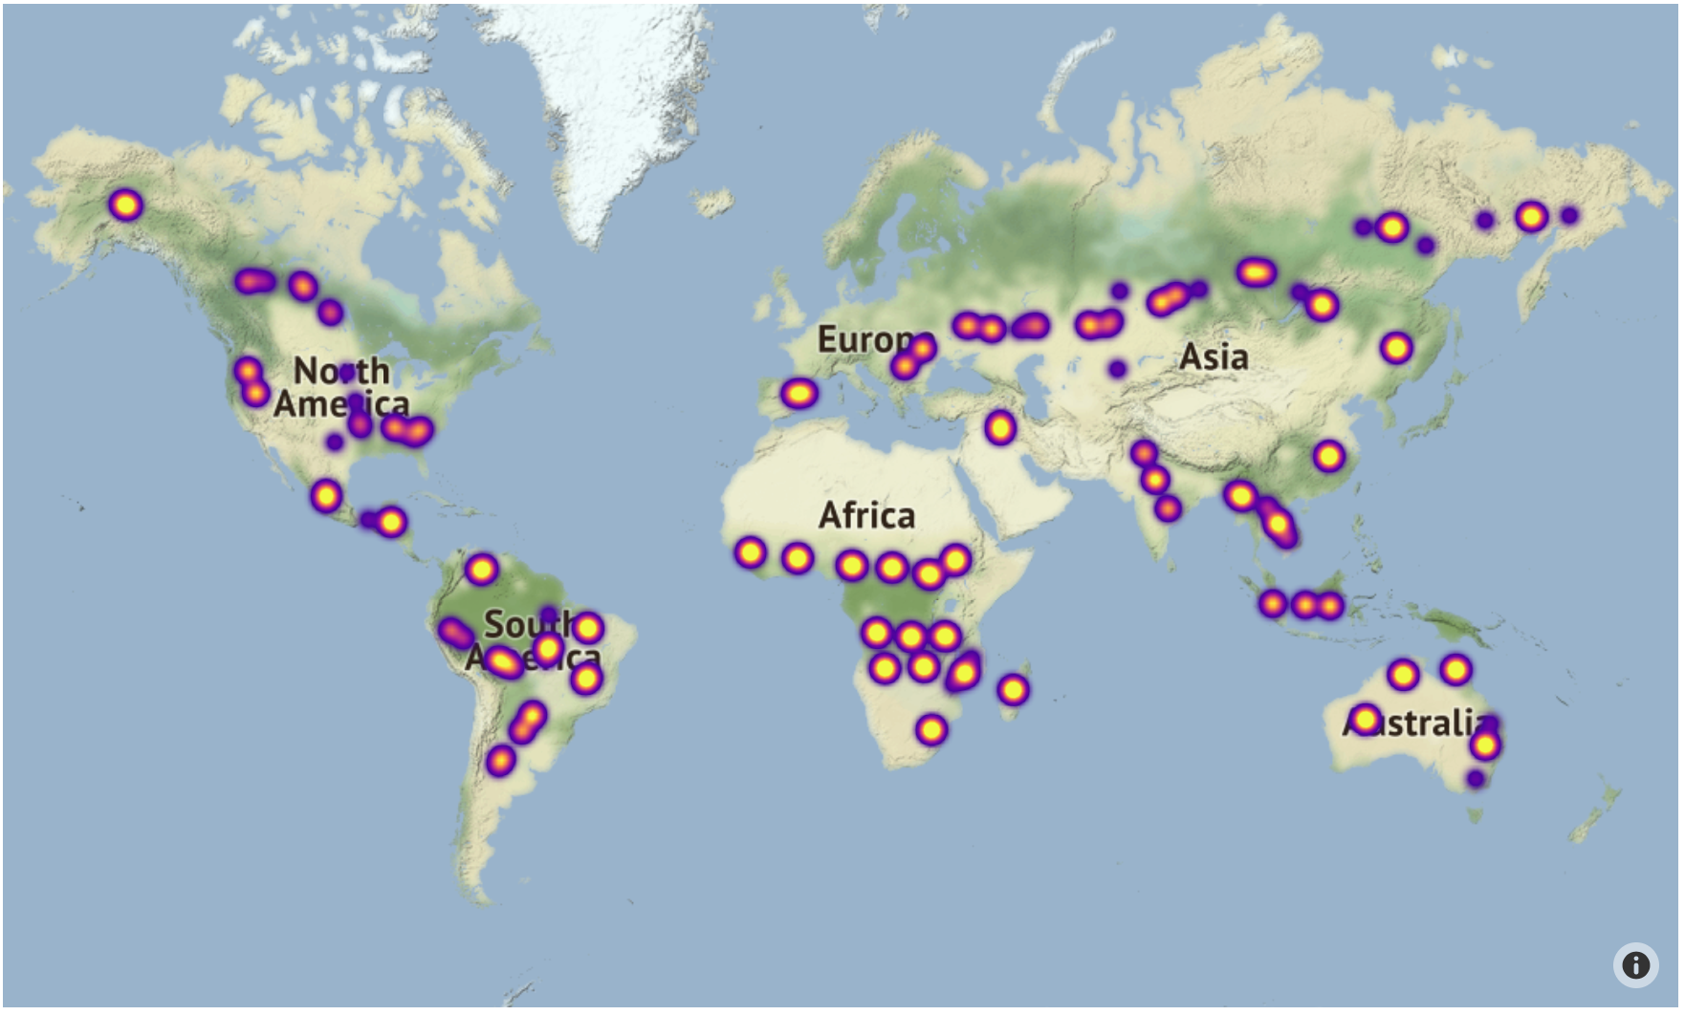
Centroids for forest
fires tend to follow
the same pattern:
Africa
Amazon Area
Australia
SE Asia

Slide 12
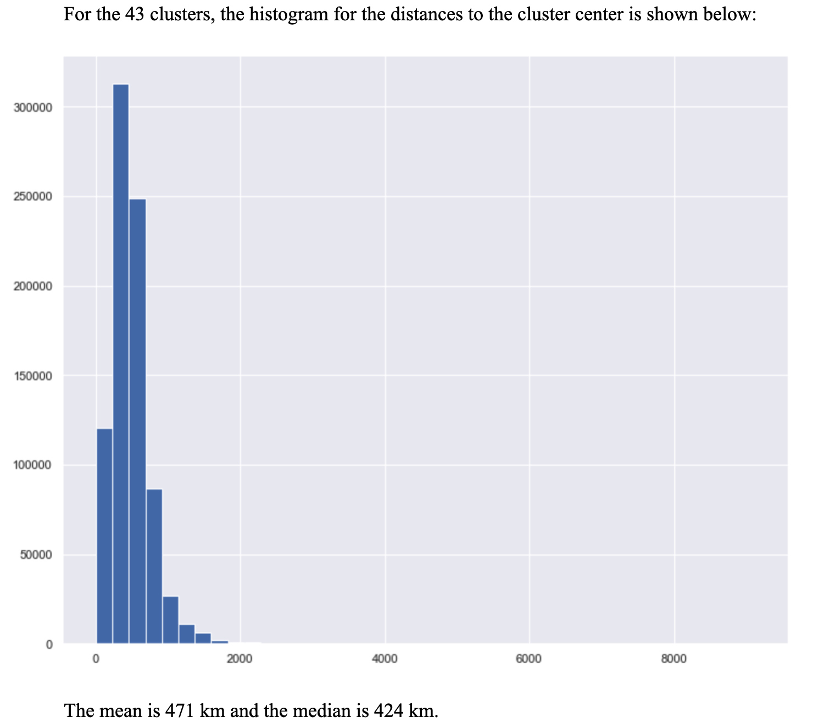

Slide 13
Conclusion
It seams to be a correlation between sea ice extent and CO2 levels.
However, this does not infer any causality between them.
For the forest fires, there is a lot of noise in the data. It is not possible
to reject the hypothesis that forest fires are not correlated to sea ice
extent and/or CO2 concentration.
For a better analyze, there are more features to be considered:
Wind patterns, ocean currents
Humidity
Temperature
Human-related forest fires, for clearing land

Slide 14
Thank you!

